Slide 1

Hi there,
To boost the project and increase engagement, we’re launching the FOX social media campaign today. Together with all FOX partners, we want to create an opportunity to share our work with a wider audience.
We want people to get the know the people behind the logo. Therefore, we created a picture frame (slide 3), which you can use to add your picture & motivation behind the project.
How to get on board? Let the step-by-step guidelines in slide 2 lead you to get our message out!
Enjoy,
The EUFIC Team

Slide 2

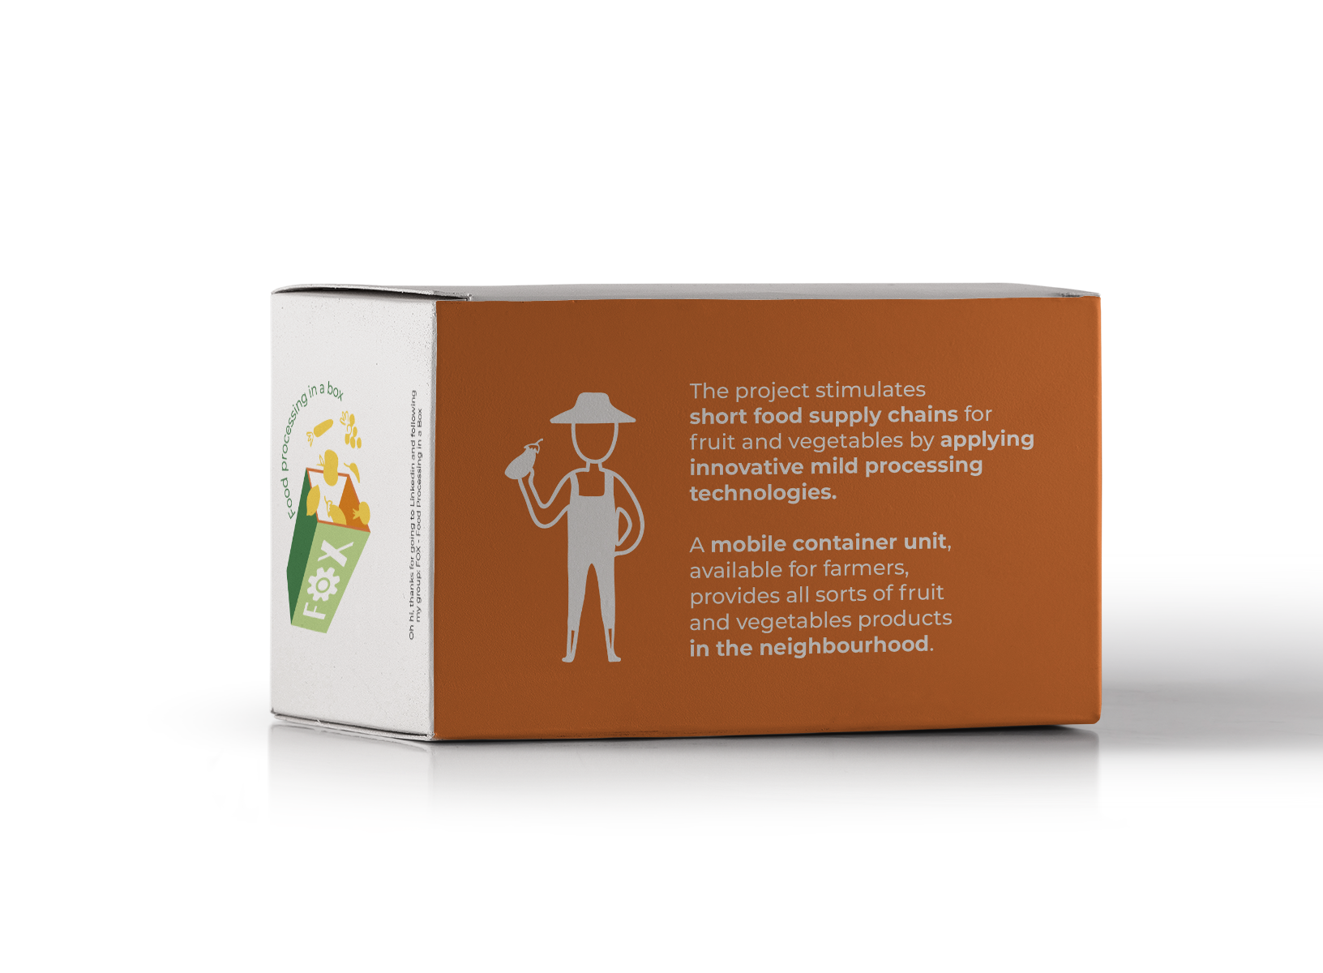

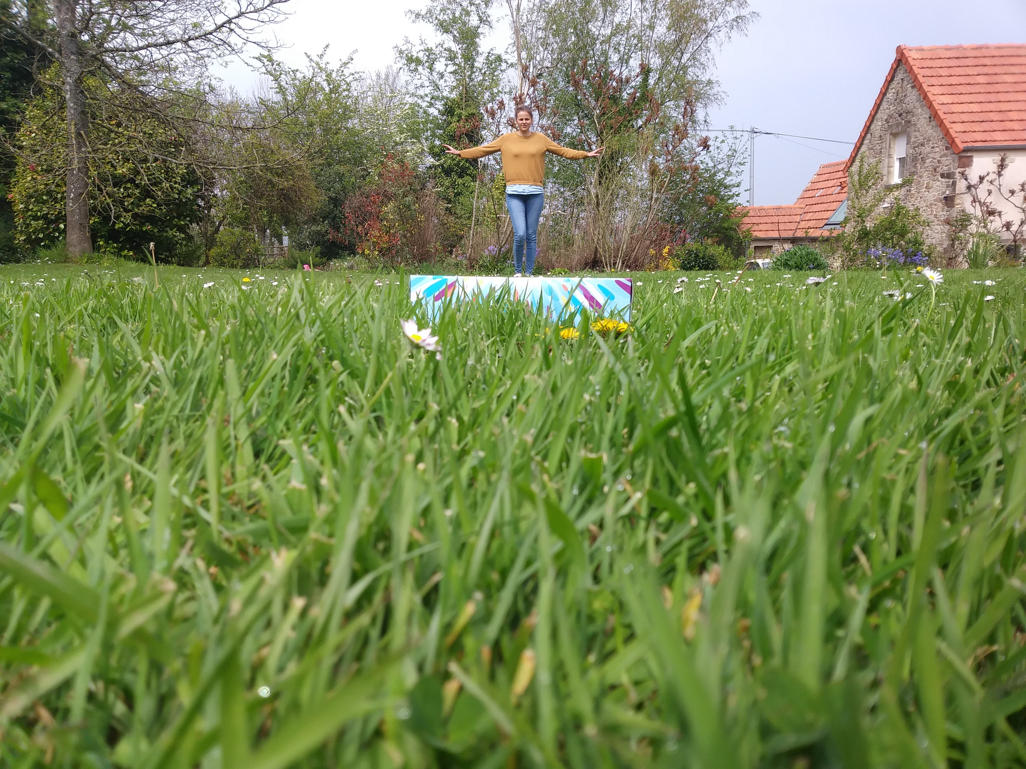
How to?
STEP 1: Take a printed FOX leaflet. At least one partner per organisation received some printed foldable leaflets. You can also print your own: fox-foodprocessinginabox.eu/fox-introductory-leaflet/
STEP 3: Write 1-2 sentences on: “How does the FOX project make me think outside the box?”
The sentence would start for everyone like that: “The project makes me think outside the box because…”
STEP 4: Add your text, your name and the name of your company/institution, as indicated on the frame in slide 3.
STEP 5: Send the frame or full .ppt back to us. We’ll keep you updated on the campaign’s latest.
Useful tips for you picture
When possible, use natural day light
Make sure the leaflet stands out & is recognisable in the picture
Don’t hesitate to change the perspective and use a particular background. The aim is to make it fun!
Step 2: Picture time! Take a photo of yourself with the FOX leaflet box. Let your creativity guide you. Find some inspiration here:

Slide 3
Name
Institute
The project makes me think outside the box because…
“…text text text text text text text
text text text
text text text text text”

Slide 4
Thank you for your contribution!

